Slide 1


Hiring Process Analytics
Ayush Saxena

Slide 2
OUTLINE:- Project Description and Approach Planning to design the case study How many males and females are Hired? What is the average salary offered in this company? Draw the class intervals for salary in the company. Draw Pie Chart / Bar Graph ( or any other graph ) to show the proportion of people working in different departments. Represent different post tiers using a chart/graph. Results and Learnings Thank you

Slide 3
Project Description And Approach
Project Description –
This is a project which is related to the Hiring Process Analytics in this we will deal with xlsv format data in which there are application_id, Interview Taken on, Status, event_name, Department, Post Name, and Offered Salary columns.
Approach –
I have gone through the data and analyzed the data then apply certain aggregation to it so that we can extract the meaningful insights of it as asked in the case study

Slide 4
Planning to design the case study
Thinking
Techstack
MS-Excel
Execution

Slide 5
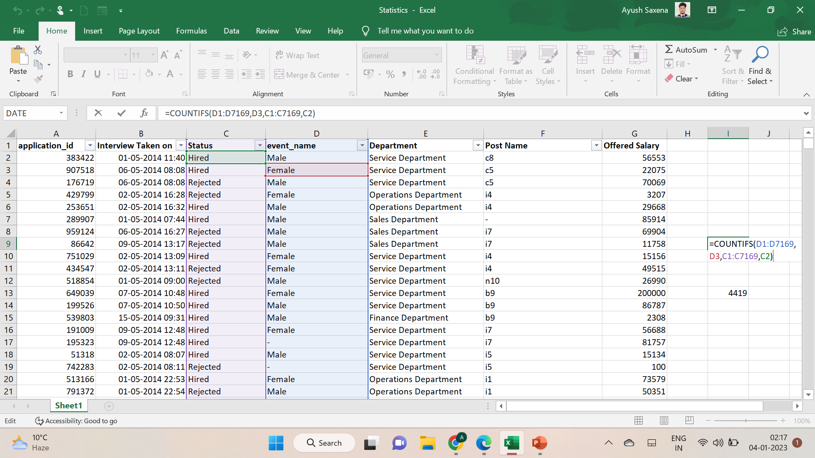
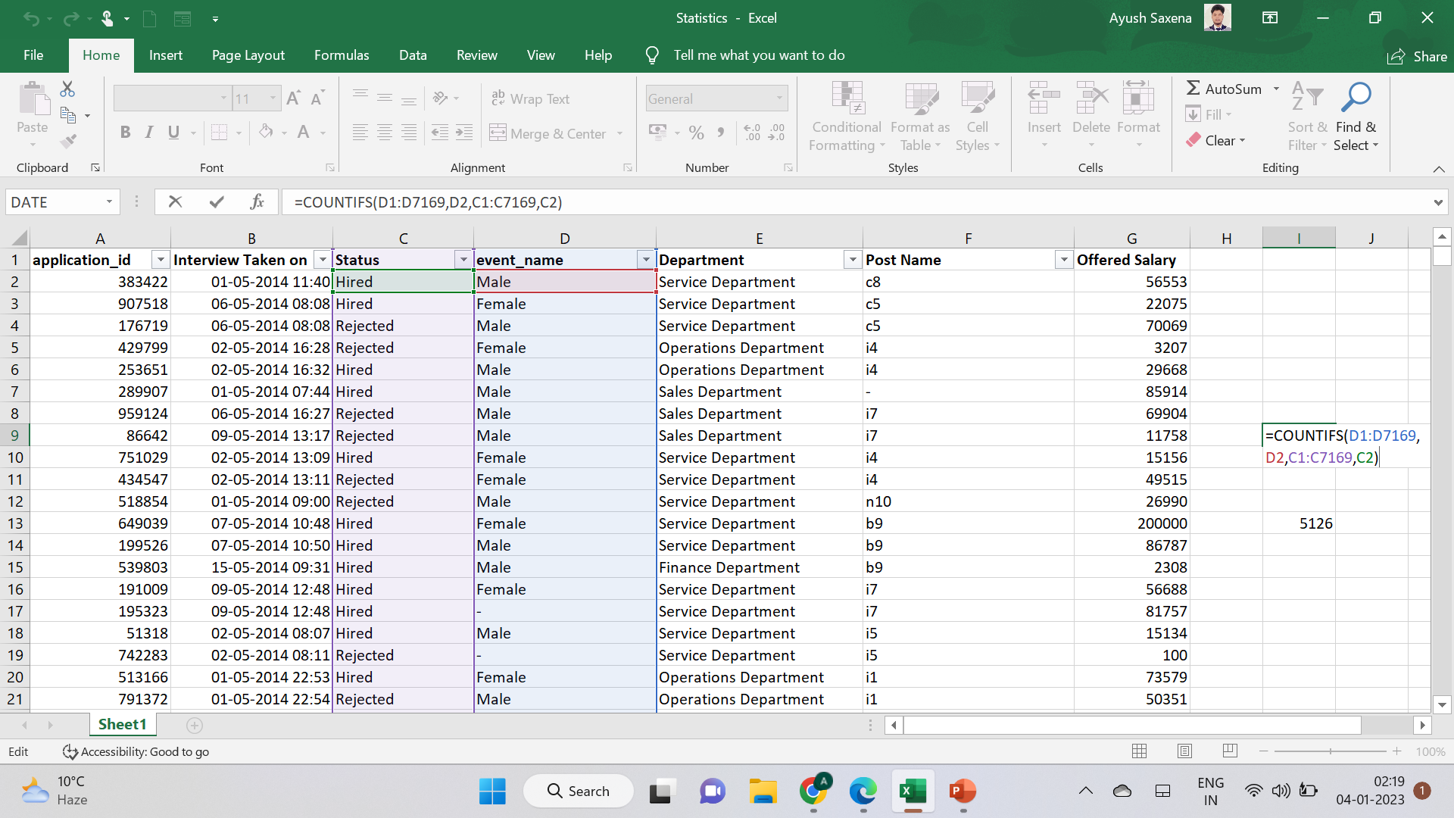
Hiring: The process of intaking people into an organization for different positions. Your task: How many males and females are Hired?
To Count the males which are Hired 2563 =COUNTIFS(D1:D7169,D2,C1:C7169,C2)
To Count the Females which are Hired 1856 =COUNTIFS(D1:D7169,D3,C1:C7169,C2)
Total Count of Males and Females which are Hired
4419
=SUM(I9,I10)

Slide 6
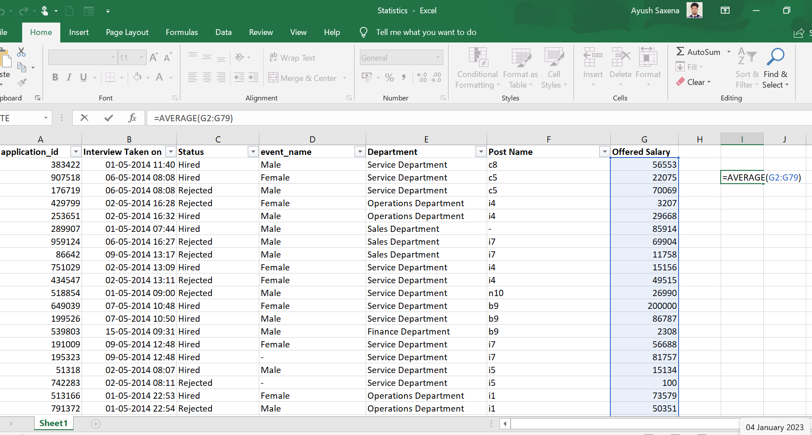
Average Salary: Adding all the salaries for a select group of employees and then dividing the sum by the number of employees in the group. Your task: What is the average salary offered in this company? Formula to extract the Average offered salary of the employee =AVERAGE(G2:G79) = 50936.04

Slide 7
Class Intervals: The class interval is the difference between the upper-class limit and the lower-class limit. Your task: Draw the class intervals for salary in the company. Upper-Class limit – Lower-class limit =MAX(C:C) - =MIN(C:C) =400000 - 100 = 399900
Row Labels | Count of Offered Salary
(blank)
100-25099 | 1763
25100-50099 | 1851
50100-75099 | 1805
75100-100099 | 1745
175100-200099 | 1
275100-300099 | 1
375100-400099 | 1
Grand Total | 7167

Slide 8
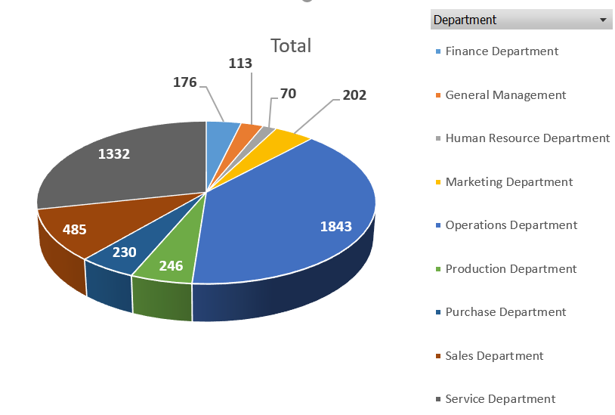
Charts and Plots: This is one of the most important parts of analysis to visualize the data. Your task: Draw a Pie Chart / Bar Graph ( or any other graph ) to show the proportion of people working in a different department.
Status | Hired
Row Labels | Count of application_id
Finance Department | 176
General Management | 113
Human Resource Department | 70
Marketing Department | 202
Operations Department | 1843
Production Department | 246
Purchase Department | 230
Sales Department | 485
Service Department | 1332
Grand Total | 4697

Slide 9
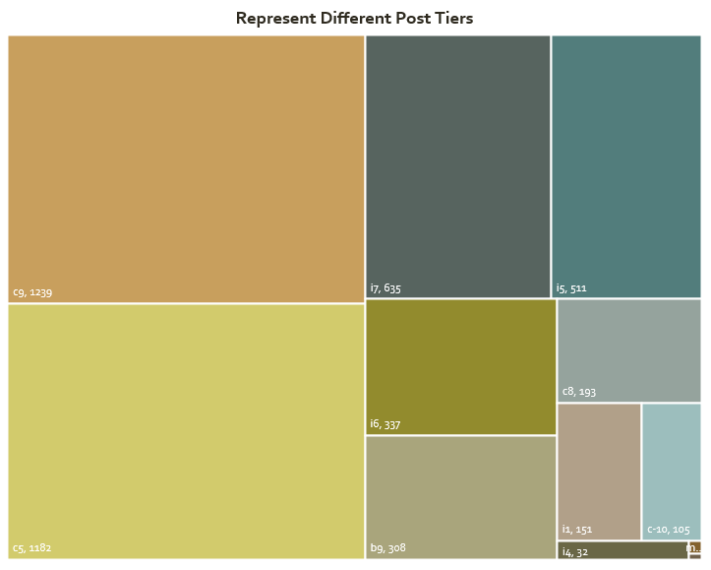
Charts: Use different charts and graphs to perform the task representing the data. Your task: Represent different post tiers using a chart/graph.
Status | Hired
Row Labels | Count of application_id
- | 1
b9 | 308
c-10 | 105
c5 | 1182
c8 | 193
c9 | 1239
i1 | 151
i4 | 32
i5 | 511
i6 | 337
i7 | 635
m6 | 2
n6 | 1
Grand Total | 4697

Slide 10
Results:- As a result, we have successfully extracted meaningful data and some of the important questions and graphs, This project helped me a lot to enhance my excel knowledge and implementation of various graphs on data.

Slide 11
Thank you
Ayush Saxena
ayushsaxenamasai@gmail.com

